Slide 1
Scholarship and Relationships
Notes:
We will be going over what it means to do the right thing when it comes to scholarship, relationships, and citizenship so we can understand what this line means from our Titan’s Creed.
This helps us come together as a community

Slide 2
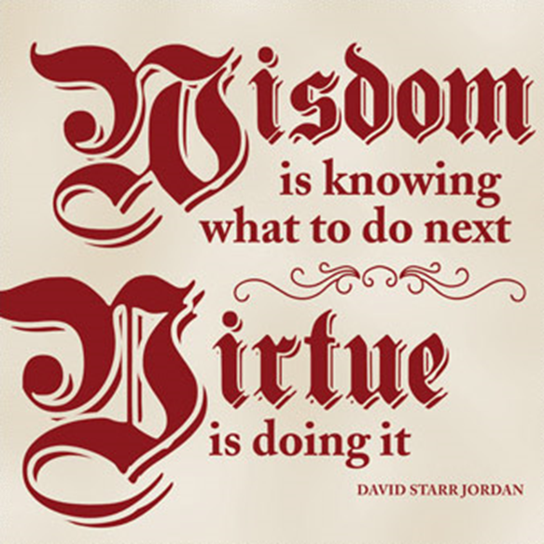
Titans celebrate virtue in scholarship, relationships, and citizenship.
Notes:
what is virtue? moral excellence / doing the right thing, not just the easy thing
Latin virtus – Comes from the Latin word for man (vir); ideal way a human should act

Slide 3
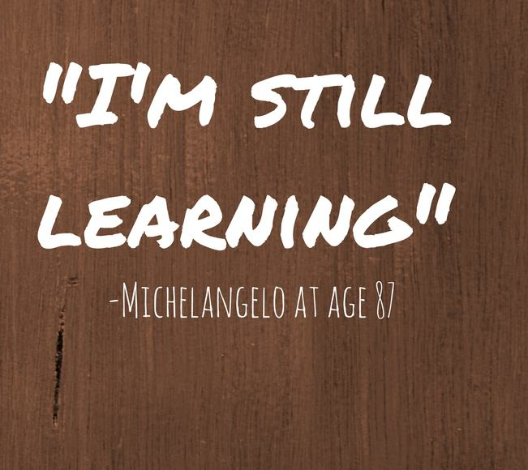
What does it mean to be a lifelong learner? How do we keep learning, even outside of school?
Titans celebrate virtue in scholarship, relationships, and citizenship.
Notes:
Learning helps us keep an open mind, communicate to others, and make good decisions.
It is obvious that we learn in the classroom, but let’s start thinking of learning outside of the classroom too
Ask students what scholarship is and see what they say. Then ask why it’s important enough to be part of our creed.
See if students can come up with examples of people being a “lifelong learner”
Example: athletes train and learn about nutrition, people learn other languages when travelling or for business, etc

Slide 4
KNOW HOW TO LEARN
VIDEO Link- Why We Should Never Stop Learning
Notes:
Encourage students to point out things in the video that stick with them, sayings or visuals
Ask what they can learn from the video and how they can become lifelong learners

Slide 5
Titans celebrate virtue in scholarship, relationships, and citizenship.
Why is community important at TCA?
How do we build relationships?
Notes:
Part of learning is also learning to communicate and to work with others
Do they think of TCA as a community even outside of the classroom?

Slide 6
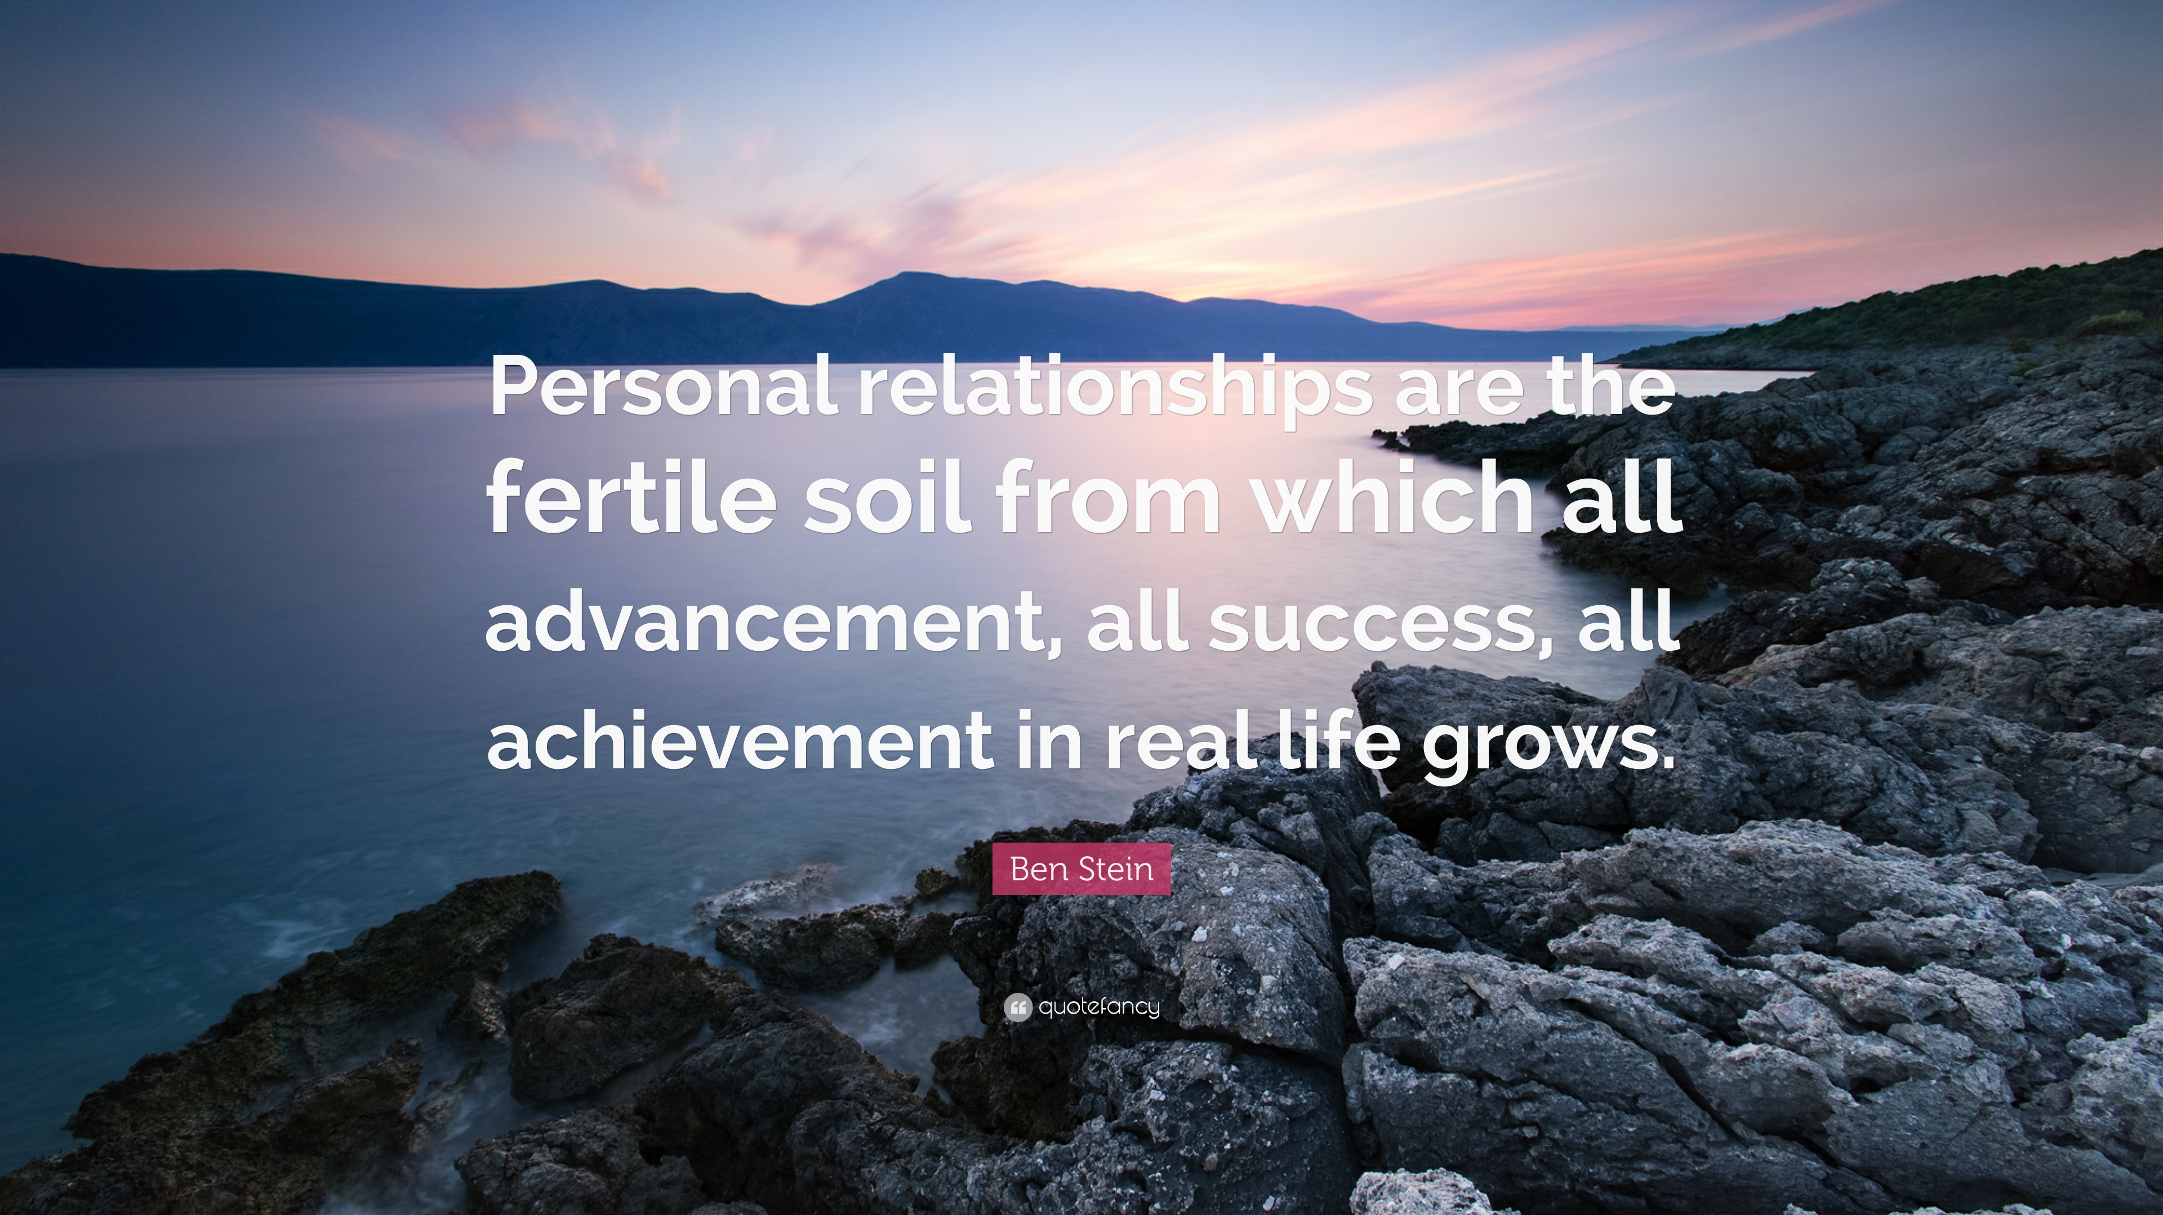
Show How You Care for… and Respect Others
Josh - opening doors and hearts
Notes:
You can become part of a community and contribute in small ways
Know that you make a difference even if you don’t realize it!

Slide 7
Titans celebrate virtue in scholarship and relationships.
Look at these lines from the Titan’s Creed.
Titans endeavor to recognize and pursue truth, beauty, goodness.
Titans take ownership of and find joy in learning.
Titans strive to be our best, do our best, and give our best to the world.
How do we do this in our everyday lives? At school?
How do we do these things when we
interact with others?

